Slide 1
Training n°4 Run: Indicators and reccuring tasks
V1.0
16/01/2022
Version
Date

Slide 2
Interactions
Use and (abuse) of emojis
Activate your Mic / Webcam if desired
Use the chat to wrote your questions
Interactions should be limited to misunderstandings or clarifications of the concepts on the agenda
Special cases & implementations will be preferred over integrator / CSM workshops
👍 😍 😮😭🎉

Slide 3
What are we going to see in this workshop?

Slide 4
Main topics
Reccuring tasks
Operational metrics
Indicators
Collecte

Slide 5
Functional Model
Cover
Risks
Describe by
Indicators
(performance)
Measures
Covered by
Declined
(in a base)
Metrics
Offered
catalog
Policies
Describe by
Operated
Measured by
Indicators (activity)
Construction
Recurring tasks
Exemptions
Gaps
Projects security
Improve efficacity
Build by
Incidents
Actions
Simple Action
Improvement Action
Building Action

Slide 6
Content of the summary
Notion’s Summary
Metrics & Reccuring tasks
API
Functional Model
Full MO
Indicators: advanced settings
To go further

Slide 7
Summary

Slide 8
Notion’s summary
Metrics
Number collected on one or more perimeters according to frequency
Key Indicator Performance (KPI)
Based on a metric formula
Activity Indicator
Based on a metric formula
Reccuring tasks
Control action
Allocated to contributors by scope
Calculated on one or more perimeters
Determines the performance of a Measure
Must be growing to be bound
Can be linked to a measure but without impact on the performance calculation
Necessarily assigned to a Measure
Regular frequency
Specifying an end date is equivalent to closing the control.
"Non calendar" tasks are defined as "every 3 months" instead of "quarterly"
Possibility to define a period of realization

Slide 9
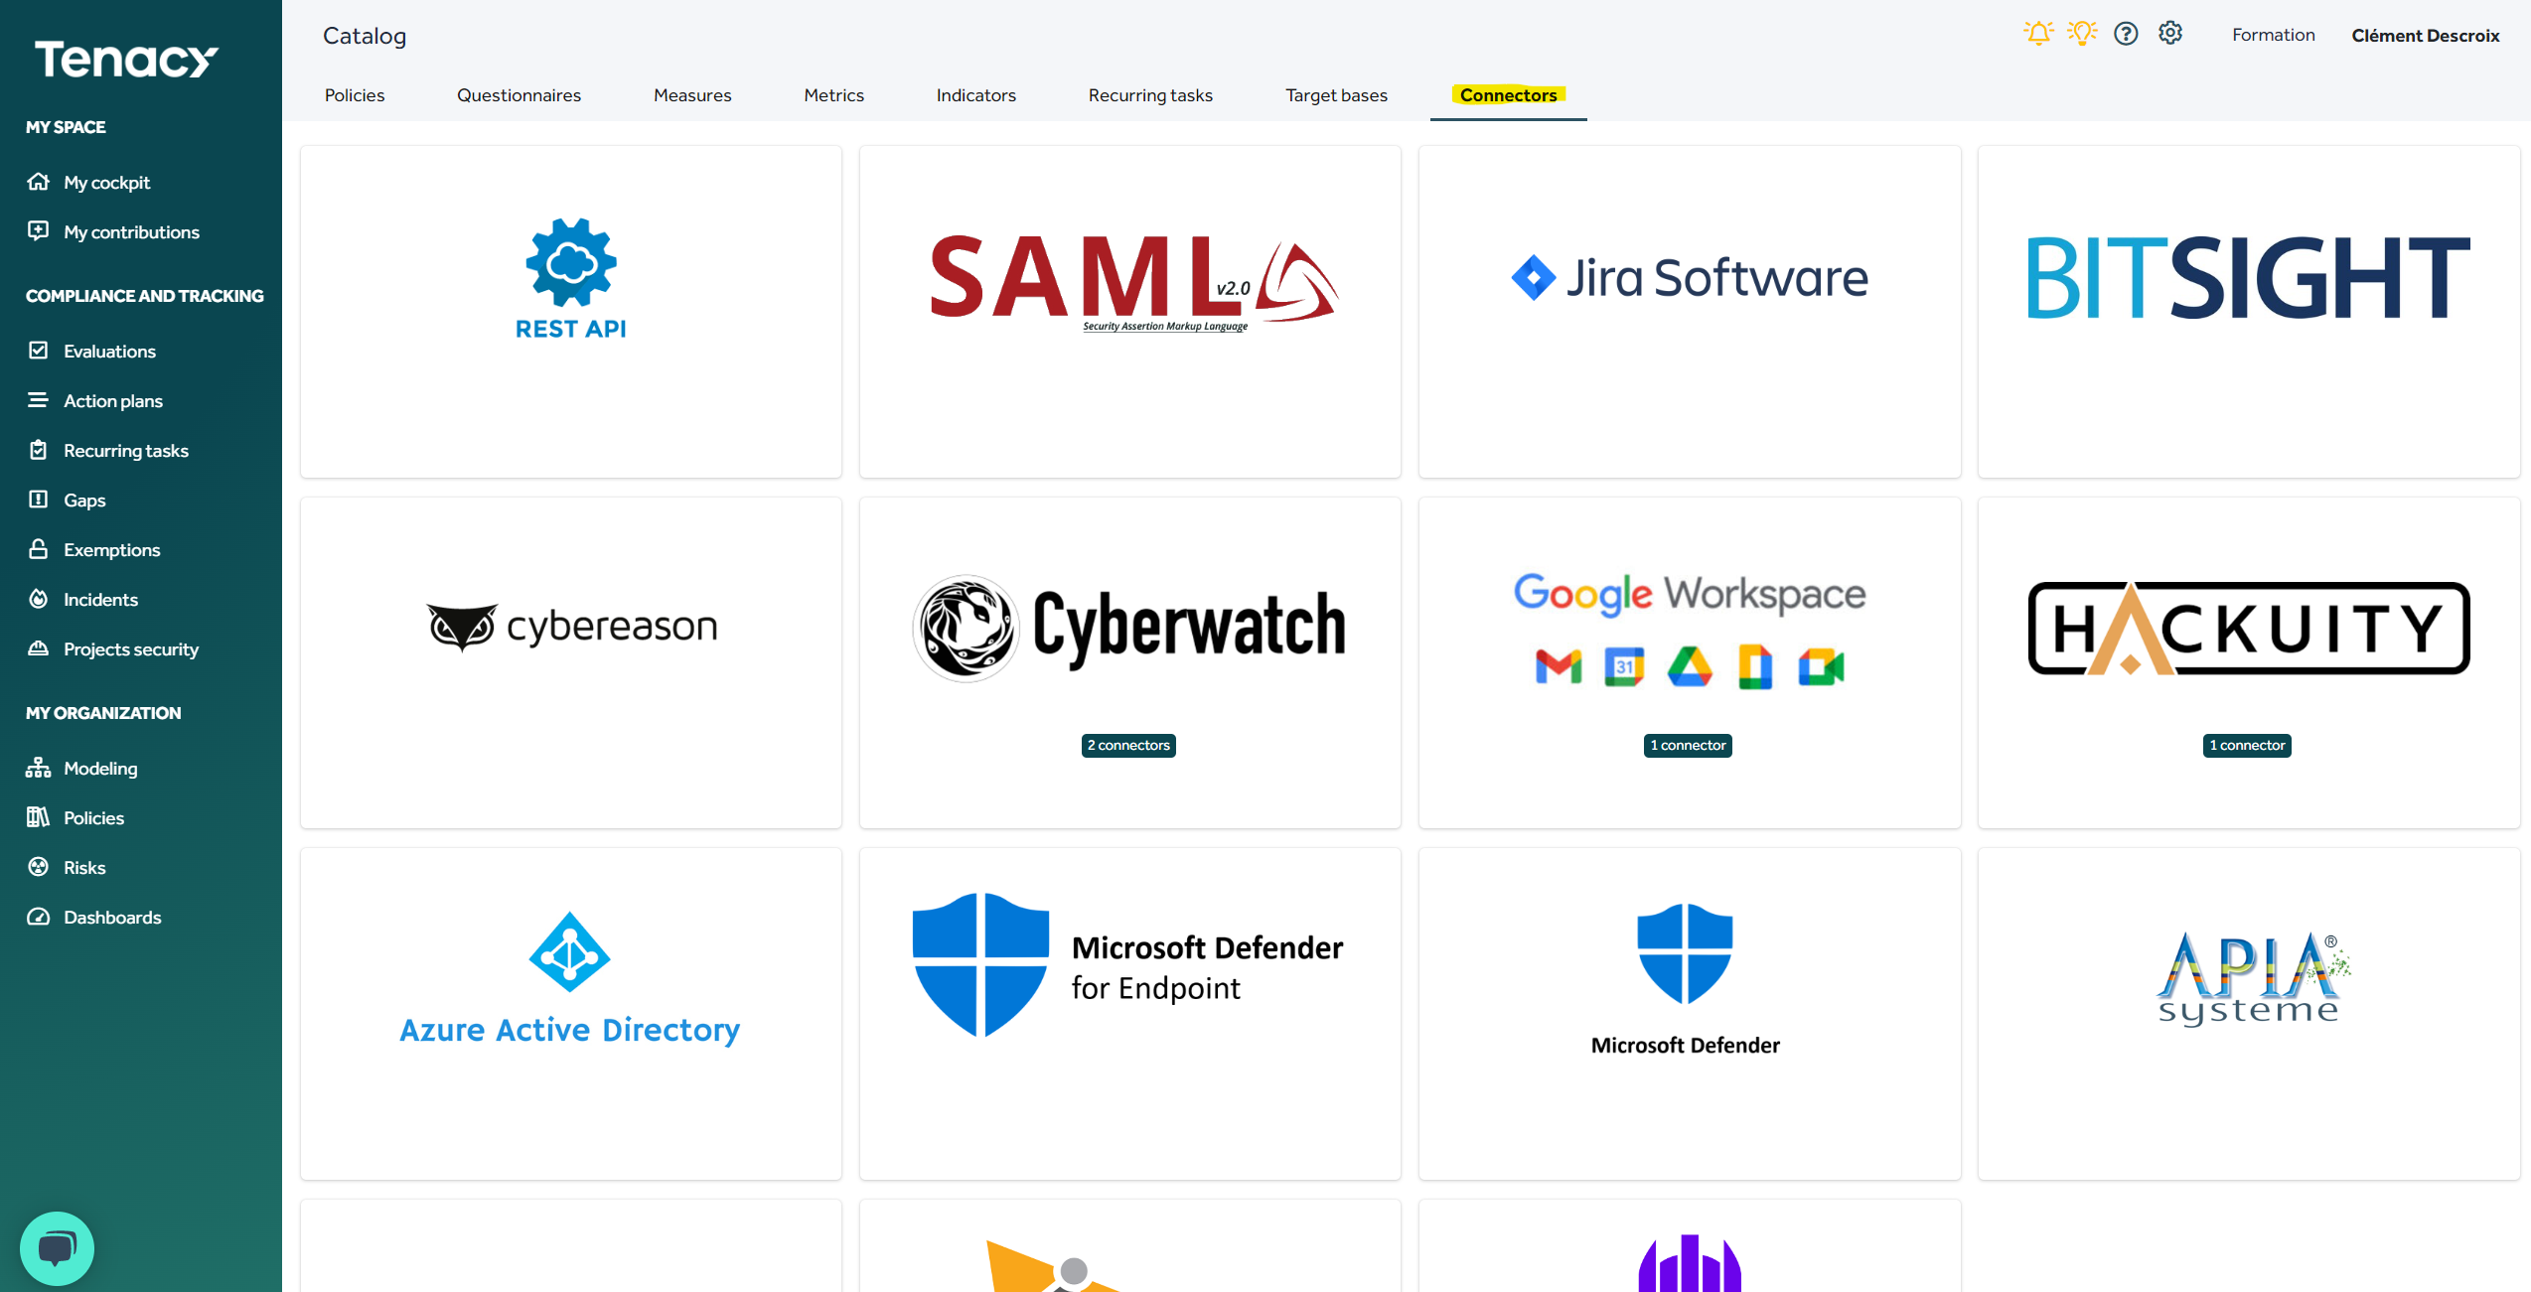
Metric collection
Collaborative
Import classeur
API
Massive data import according to the template in the solution
Ability to import history
Partial import possible
Conservez un backup des données exportés
Import past data only if necessary
Public API
Pushing metrics on the PLC
Connectors
Automated collection by the solution (according engine available in the catalogue)
Assignment of metrics to contributors
Entering metrics for the last closed period
Attention to changing the history

Slide 10
API

Slide 11
Introduction
Tenacy’s API allow to interact (GET/POST) with operationnals metrics.
Functionnal documentation is available « in-app » on :
https://app.tenacy.io/doc/public_api
Technical documentation technique is available on:
https://api.tenacy.io/api/public/doc
Comments can be added on metrics updated, see on example for more informations
In case you use a dedicated tenant make sure to modify the urls and replace tenancy.io by TenantName.tenancy.io
On the same model you must use api. TenantName.tenacy.io

Slide 12
Date Management
In Tenacy the dates are managed in UTC format, so this must be taken into account when using API.
For example :
If you used the API at 01am July 1st (Paris Time), the solution will record values for June 30th
It is therefore necessary to set up the offset between your time zone and UTC to match the correct date.
It is advised to use the API only from 2:10 am in order to be compliant with summer/ winter time

Slide 13
Authentication
The Tenacy API supports 3 authentication methods:
The API key is passed as a GET parameter to the request
https://api.tenacy.io/api/public/XXX?api_key=[YOUR_API_KEY]
the API key is passed in the "Authorization" header
The key can be passed in the request body in JSON, key "api_key".
Usefull link and example
https://4bes.nl/2020/08/23/calling-a-rest-api-from-powershell/

Slide 14
Example Script Powershell: Values in script
$token= « CHANGE_ME »
$perimeter= "PERIMETER_ID"
$metric= "METRIC_ID "
$comment= « collected by John Doe on 13th September "
$endpoint='https://api.tenacy.io/api/public/metrics/'+$perimeter+'/'+$metric
$body = @{
value = 100
comment= $comment
} | ConvertTo-Json
$header = @{
"Accept"="application/json"
"Authorization"=$token
}
$params = @{
Uri = $endpoint
Headers = $header
Method = 'PUT'
Body = $body
ContentType = 'application/json'
}
Invoke-RestMethod @params | Format-List

Slide 15
Example Script Powershell: values in powershell format
$token= « CHANGE_ME »
$perimeter= "PERIMETER_ID"
$metric= "METRIC_ID "
$endpoint='https://api.tenacy.io/api/public/metrics/'+$perimeter+'/'+$metric$body = @{value = x} | ConvertTo-Json
$header = @{"Authorization"=$token}
$params = @{Uri = $endpointHeaders = $headerMethod = 'PUT'Body = $bodyContentType = 'application/json'}
Invoke-RestMethod @params | Format-List

Slide 16
Example Script Powershell: Data handling in powershell format
$token= « CHANGE_ME »
$perimeter= "PERIMETER_ID"
$metric= "METRIC_ID "
$myMetrics = [PSCustomObject]@{
metrics = @()
}
$myMetrics.metrics+=@{value=$value;metric_id=$metric}
$myMetrics.metrics+=@{value=$value2;metric_id=$metric2}
$endpoint="https://api.tenacy.io/api/public/metrics/"+$perimeter
$body=$myMetrics | ConvertTo-JSON
$header = @{"Authorization"=$token}
Invoke-RestMethod -Method 'Put' -Headers $header -Uri $endpoint -Body $body -ContentType 'application/json'

Slide 17
Example with Active Directory LDAP
$token= « CHANGE_ME »
$perimeter= "PERIMETER_ID"
$metric= "METRIC_ID "
$endpoint='https://api.tenacy.io/api/public/metrics/'+$perimeterID+'/'+$metricID
$NBAdmin= Get-ADGroupMember -Identity "Admins du Domaine" | Select-Object Name | measure $valeur_api = $NBAdmin.Count
$body = @{ value = $valeur_api } | ConvertTo-Json
$header = @{ "Accept"="application/json" "Authorization"= $token }
$params = @{ Uri = $endpoint Headers = $header Method = 'PUT' Body = $body ContentType = 'application/json’ }
[Net.ServicePointManager]::SecurityProtocol = [Net.SecurityProtocolType]::Tls12 Invoke-RestMethod @params | Format-List

Slide 18
Key Performance Indicator

Slide 19
Key Performance Indicator
In Tenacy , Key Performance Indicators are:
In percentages
An indicator must be between 0 and 1,
The solution will take it into account and turn it into a percentage
Positives
Always higher up!
The solution compares and averages indicators
It is possible to monitor negative indicators, only not to link them to measures
%
↗

Slide 20
Negatives indicators
Exemple: phishing campaign
I’m a Tenacy user and I would like to follow the results of my phishing campaigns.
I would also use it to track my “information security awareness” measure
So I need to create a positive indicator and link it to my measure.
M.PHI.01: Number of phishing emails sent
M.PHI.02: Number of phishing emails clicked
I.PHI.01 is positive, measure related, impacts performance and risks
I.PHI.02 is negative, must not be bound, can be used one in the perimety.

Slide 21
Aggregation Advanced settings

Slide 22
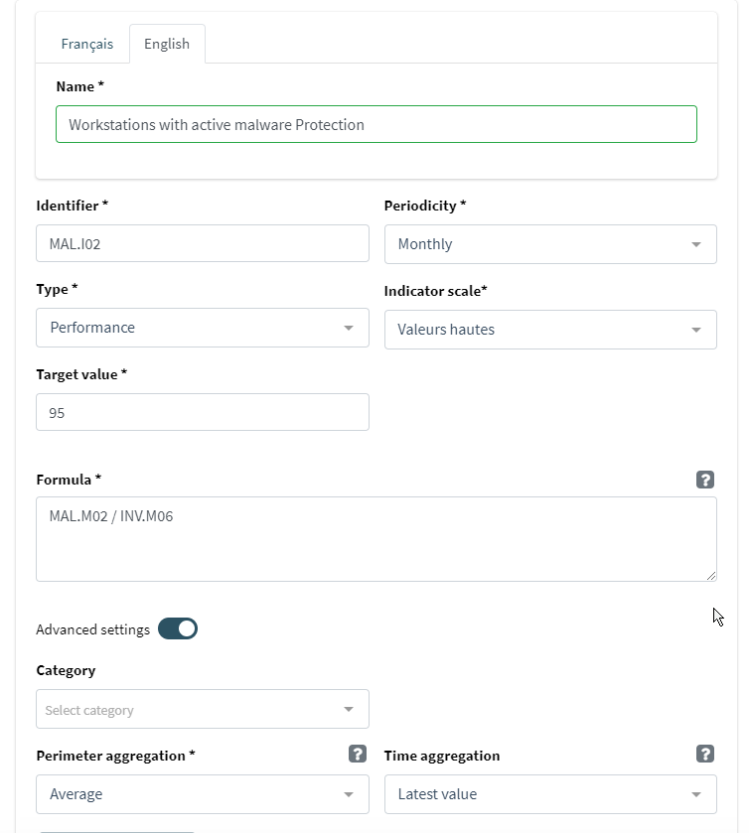
Advanced settings – Aggregation of perimeters
Aggregation parameters are used to calculate an indicator when there are multiple metric values
MAL.M02: Number of posts with malware protection
INV.M06: Number of posts

Slide 23
Case n°1: Aggregation of perimeters
I want my consolidated indicator for 3 perimeters : Perim1 (P1); Perim2 (P2), Perim3 (P3)
Il y à 3 valeurs différentes pour chacune des métriques, MAL.M02_{P1 ,}MAL.M02_{P2} ,MAL.M02_{P3} et INV.M06_{P1} ,INV.M06 _{P2} ,INV.M06 _{P3}.
For example :
The factor defined how these values are managed.
MAL.M02_{P1} | INV.M06_{P1} | MAL.M02_{P2} | INV.M06 _{P2} | MAL.M02_{P3} | INV.M06 _{P3}
290 | 350 | 280 | 300 | 10 | 12
Factor | Result
Sum | 87,6%
Average | 87,6%
Minimum | 83,3%
Maximum | 82,9%
Median | 93,3%
$$\frac{\text{MAL}\text{.}\text{M}\text{02}\text{P}\text{1 } +\text{MAL}\text{.}\text{M}\text{02}\text{P}\text{2 } +\text{MAL}\text{.}\text{M}\text{02}\text{P}3}{\text{INV}\text{.}\text{M}\text{06}\text{P}\text{1 } +\text{INV}\text{.}\text{M}\text{06}\text{P}\text{2}+\text{INV}\text{.}\text{M}\text{06}P3} =\frac{290+280+10}{350+300+12}=\frac{580}{662}≈0,876$$
$\frac{\overline{\text{MAL}\text{.}\text{M}\text{02}\text{P}\text{1 } +\text{MAL}\text{.}\text{M}\text{02}\text{P}\text{2 } +\text{MAL}\text{.}\text{M}\text{02}\text{P}3}}{\overline{\text{INV}\text{.}\text{M}\text{06}\text{P}\text{1 } +\text{INV}\text{.}\text{M}\text{06}\text{P}\text{2}+\text{INV}\text{.}\text{M}\text{06}P3}}=\frac{\overline{290+280+10}}{\overline{350+300+12}}≈\frac{193,33}{220,66}$ $≈0,876$
$$\frac{\text{min}\text{(}\text{MAL}\text{.}\text{M}\text{02}\text{P}\text{1 } +\text{MAL}\text{.}\text{M}\text{02}\text{P}\text{2 } +\text{MAL}\text{.}\text{M}\text{02}\text{P}3)}{\text{min}\text{(}\text{INV}\text{.}\text{M}\text{06}\text{P}\text{1 } +\text{INV}\text{.}\text{M}\text{06}\text{P}\text{2}+\text{INV}\text{.}\text{M}\text{06}P3)} =\frac{min⁡(290+280+10)}{min⁡(350+300+12)}=\frac{10}{12}≈0,833$$
$$\frac{\text{max}\text{(}\text{MAL}\text{.}\text{M}\text{02}\text{P}\text{1 } +\text{MAL}\text{.}\text{M}\text{02}\text{P}\text{2 } +\text{MAL}\text{.}\text{M}\text{02}\text{P}3)}{\text{max}\text{(}\text{INV}\text{.}\text{M}\text{06}\text{P}\text{1 } +\text{INV}\text{.}\text{M}\text{06}\text{P}\text{2}+\text{INV}\text{.}\text{M}\text{06}P3)} =\frac{max⁡(290+280+10)}{max⁡(350+300+12)}=\frac{290}{350}≈0,829$$
$$\frac{\text{med}\text{(}\text{MAL}\text{.}\text{M}\text{02}\text{P}\text{1 } +\text{MAL}\text{.}\text{M}\text{02}\text{P}\text{2 } +\text{MAL}\text{.}\text{M}\text{02}\text{P}3)}{\text{med}\text{(}\text{INV}\text{.}\text{M}\text{06}\text{P}\text{1 } +\text{INV}\text{.}\text{M}\text{06}\text{P}\text{2}+\text{INV}\text{.}\text{M}\text{06}P3)} =\frac{med⁡(290+280+10)}{med(350+300+12)}=\frac{280}{330}≈0,933$$

Slide 24
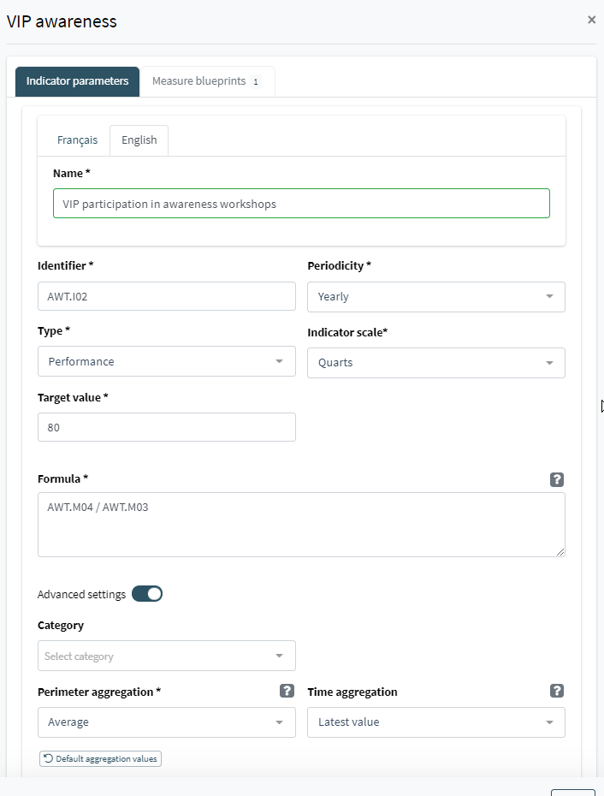
Advanced parameters – Aggregation of time
Temporal aggregation is used when the frequency of the metrics used is different:
- Metric used on two indicators
- Consolidated view from a higher-level perspective
AWT.M04: Number of VIPs
AWT.M03: VIPs who participated in the training
In this example, AWT.M03 is quarterly : 4 trainings in 1 year
The two metrics can be collected over a different time period from the indicator. The same parameter will then be applied.

Slide 25
Case n°2 : Temporal aggregation
I want to have my indicator consolidated over a year :
There are 4 different values per metric : AWT.M03 (AWT.M03_{Q1}, AWT.M03_{Q2}, AWT.M03_{Q3}, AWT.M03_{Q4} and 1 for AWT.M04
The parameter will define how the annual value is managed
AWT.M04 | AWT.M03 | MAL.M02_{P2} | INV.M06 _{P2} | MAL.M02_{P3}
2020 | AWT.M03_{Q1} | AWT.M03_{Q2} | AWT.M03_{Q3} | AWT.M03_{Q4}
10 | 8 | 10 | 0 | 6
Factor | Result
Sum | 240%
Average | 60%
Last value | 60%
Minimum | 0%
Maximum | 100%
Median | 81%
$$\frac{\text{AWT}\text{.}\text{M}\text{03}\text{Q}\text{1} +\text{AWT}\text{.}\text{M}\text{03}\text{Q}\text{2} +\text{AWT}\text{.}\text{M}\text{03}\text{Q}\text{3} +\text{AWT}\text{.}\text{M}\text{03}\text{Q}4}{\text{AWT}\text{.}\text{M}\text{04} 3} =\frac{810+0+6}{10}=\frac{24}{10}≈2,4$$
$\frac{\text{AWT}\text{.}\text{M}\text{03}\text{Q}\text{1} +\text{AWT}\text{.}\text{M}\text{03}\text{Q}\text{2} +\text{AWT}\text{.}\text{M}\text{03}\text{Q}\text{3} +\text{AWT}\text{.}\text{M}\text{03}\text{Q}4}{\overline{AWT.M043}}=\frac{\overline{8+10+0+6}}{10}=\frac{6}{10}$ $=0,6$
$$\frac{\text{AWT}\text{.}\text{M}\text{03}\text{Q}4}{\overline{AWT.M043}}=\frac{6}{10}=0,6$$
$$\frac{\text{min}\text{(}\text{AWT}\text{.}\text{M}\text{03}\text{Q}\text{1} +\text{AWT}\text{.}\text{M}\text{03}\text{Q}\text{2} +\text{AWT}\text{.}\text{M}\text{03}\text{Q}\text{3} +\text{AWT}\text{.}\text{M}\text{03}\text{Q}4)}{AWT.M04} =\frac{min(8,10,0,6)}{10}=\frac{0}{10}=0$$
$$\frac{\text{max}\text{(}\text{AWT}\text{.}\text{M}\text{03}\text{Q}\text{1} +\text{AWT}\text{.}\text{M}\text{03}\text{Q}\text{2} +\text{AWT}\text{.}\text{M}\text{03}\text{Q}\text{3} +\text{AWT}\text{.}\text{M}\text{03}\text{Q}4)}{10} =\frac{max(8,10,0,6)}{10}=\frac{10}{10}=1$$
$$\frac{\text{med}\text{(}\text{AWT}\text{.}\text{M}\text{03}\text{Q}\text{1} +\text{AWT}\text{.}\text{M}\text{03}\text{Q}\text{2} +\text{AWT}\text{.}\text{M}\text{03}\text{Q}\text{3} +\text{AWT}\text{.}\text{M}\text{03}\text{Q}3)}{10} =\frac{med(8,10,0,6)}{10}=\frac{8,1006}{10}≈0,81$$

Slide 26
How do I set the right parameter?
It depends on “What do I want to control?”
In some cases, the amount is acceptable (Total number of incidents) but in other cases it would make no sense (participation in awareness workshops)
The indicators of the knowledge base are defined with a default parameter, but once operated the value is modifiable.
It is possible to set the same indicator twice with different parameters to report differently for example :
Average Awareness Participation and Maximum Participation
It is possible to create leading indicators with aggregations of scope and time.

Slide 27
How to link a task to metrics?
On a recurring task, the input is collected.
The result of the check is collected by entering metrics.
For this, the metrics must be linked to the recurring task.
Recurring task
control
Measure
determine
Metric
Indicator
The metric is here the result of the recurring task

Slide 28
SKIP
Modus operandi : Collect metrics from contributors

Slide 29
MO
Definition of metrics / indicators
Assignment of metrics to Contributors
Entering metrics
Relaunch
Pilot
Pilot
Contributor
Pilot
Notes:
Mode opératoire

Slide 30
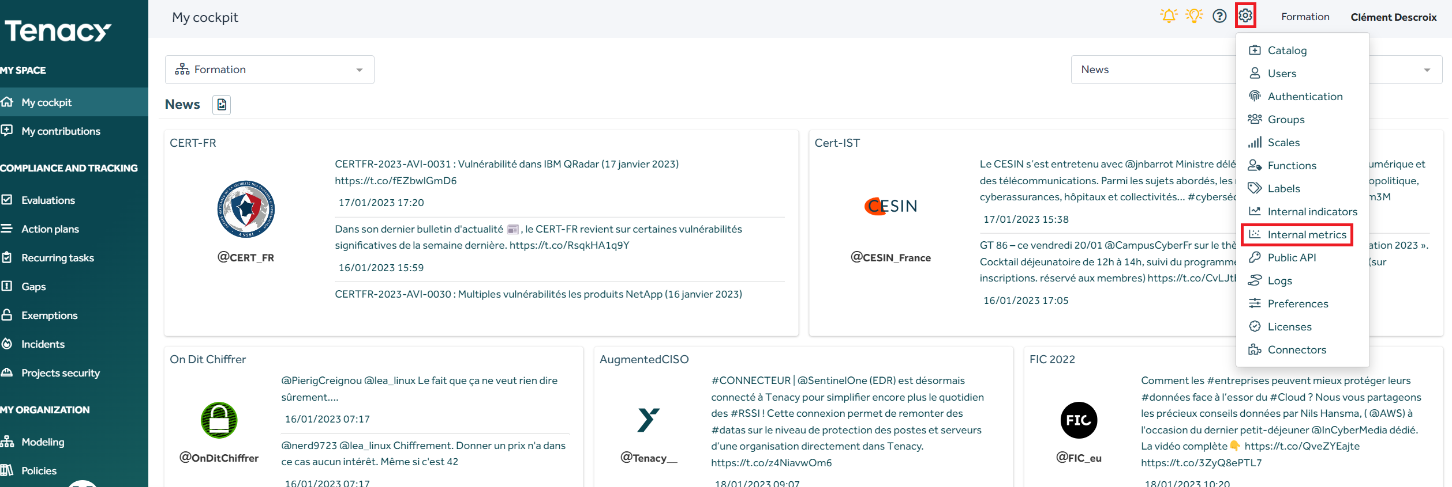
Definition of metrics / indicators
Role: Pilot

Slide 31
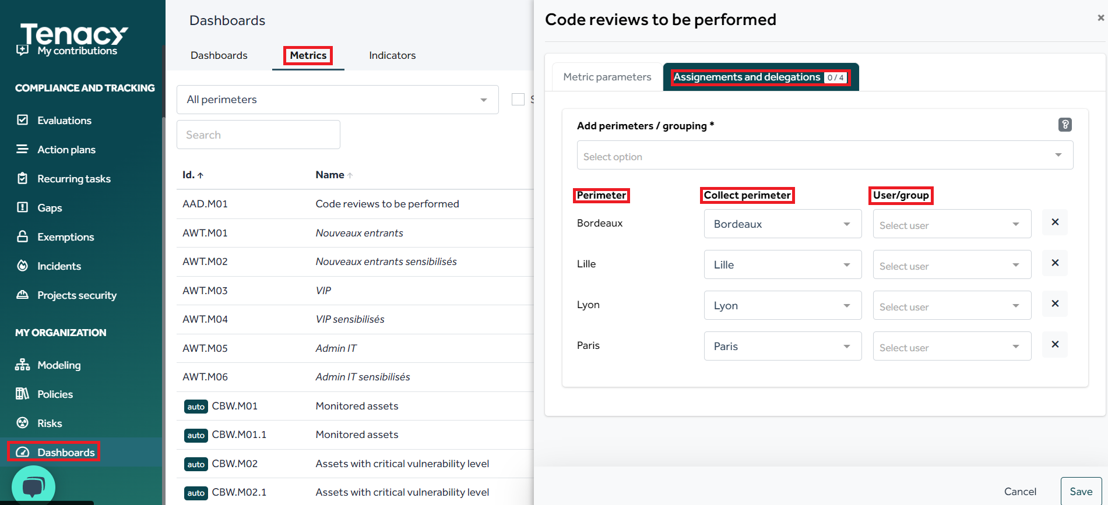
Metric assignment
Role : Pilot
Purpose: Assign a metric for a Tenacy user to enter.
Perimeter: The perimeter on which the metric is existing
Collector Perimeter: The scope in charge of collecting the metric (a DSI scope for example or Corporate IT)
User/ group: The person or persons in charge of entering the metric in the solution
Clic on the metric to add

Slide 32
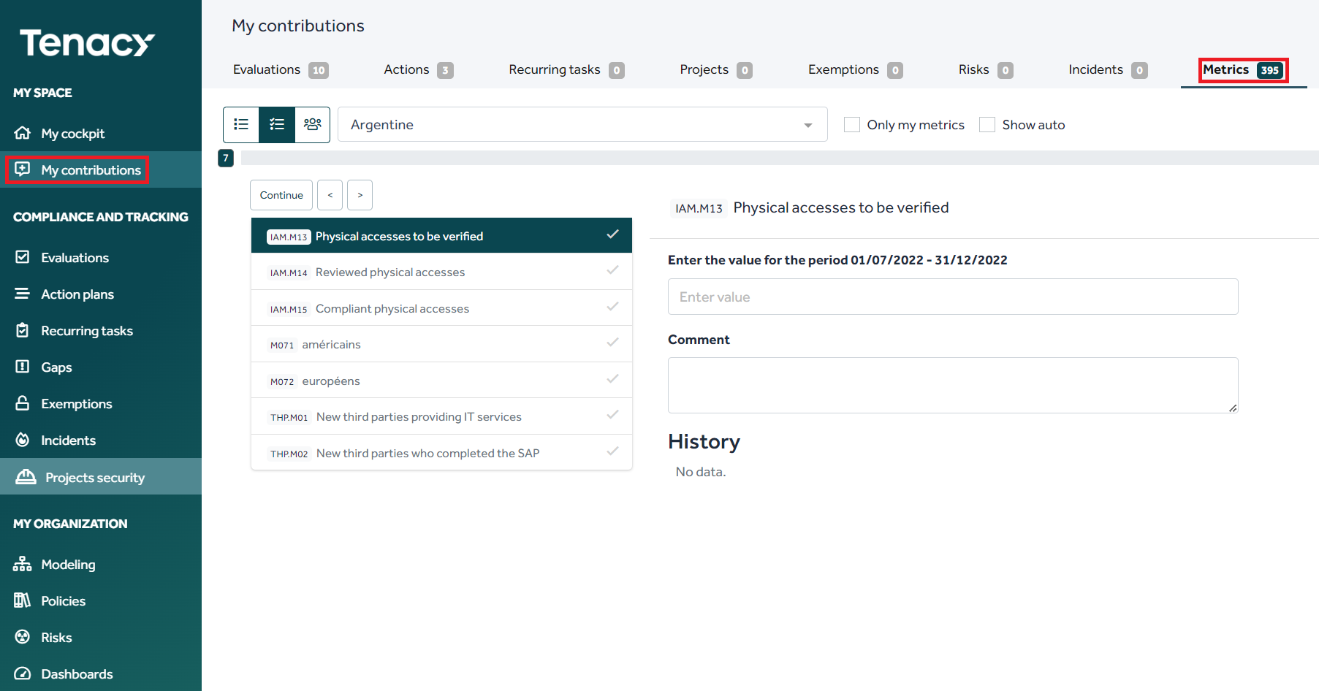
Entering metrics / Consultation
Role : Contributor
As a collaborator you will find in «My contributions» all the objects that are assigned to you.
In “entering metrics” you will have a view of all the metrics expected for the current period assigned to you.
The history is displayed if it exists.

Slide 33
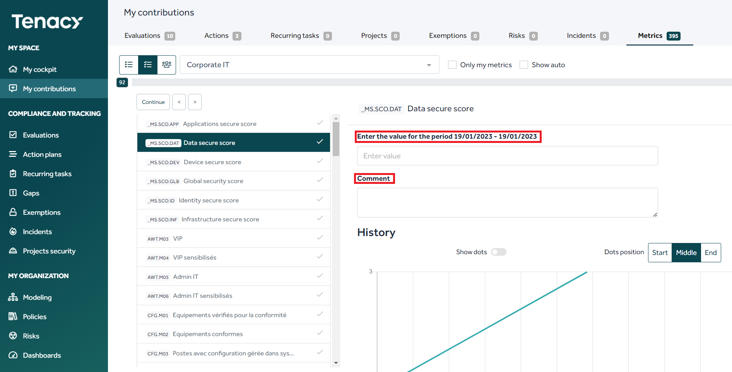
Entering metrics
Role : Contributor
Purpose: Enter the value of a metric for the expected period
In "entering metrics"
The current period is displayed above the input field.
A comment field is present to specify or document the value. This field is optional.
This entry is to be done from the first day of the period. From December 1st you collect the metrics for November.
An administrator may need to collect metrics following the same process. By default, all metrics will be visible to the administrator.

Slide 34
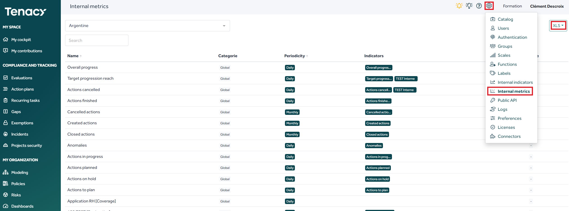
Other method of collection
EXCEL
It is possible to integrate metrics via Excel tables, a template is available in the solution.
This integration mode is very useful for history import.
It can be used for recurring imports, but be careful, it also allows to overwrite/modify the values in place:
Import only necessary columns/rows
Keep a copy of the “backup” export

Slide 35
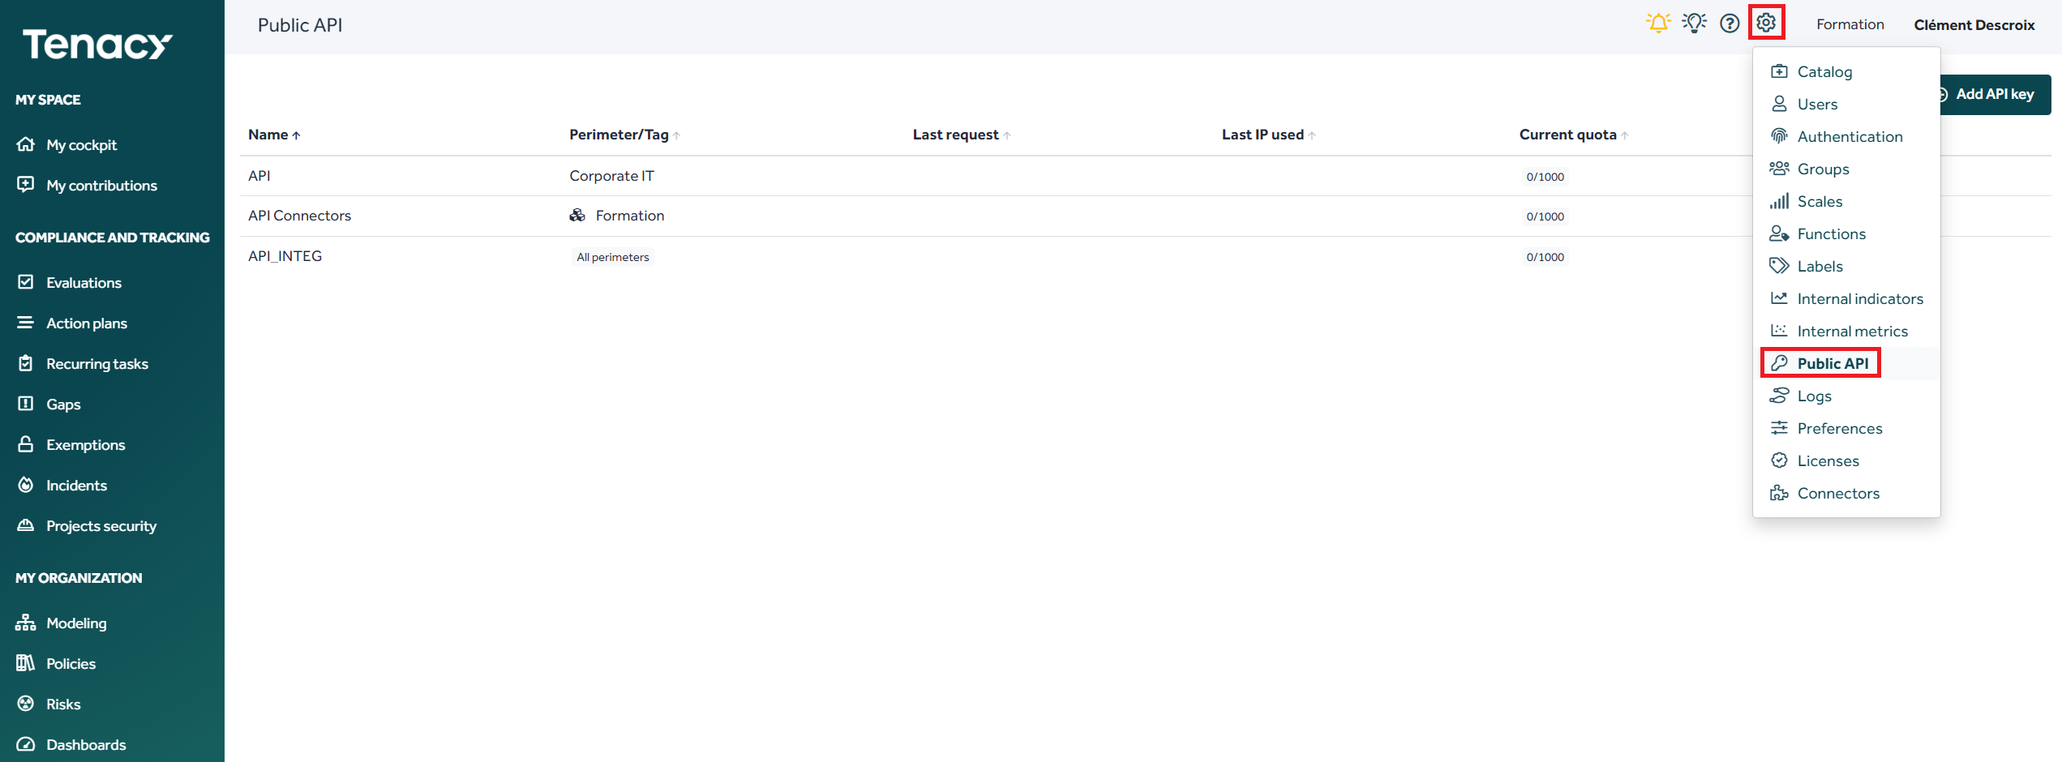
Other method of collection
API
It is possible to integrate metrics by using a public API, it is possible for you to generate or supervise your keys from the «Settings» tab.
The API is “listening” and allows you to push metrics from your sources in Tenacy
The functional documentation : https://app.tenacy.io/doc/public_api
The technical documentation : https://api.tenacy.io/api/public/doc

Slide 36
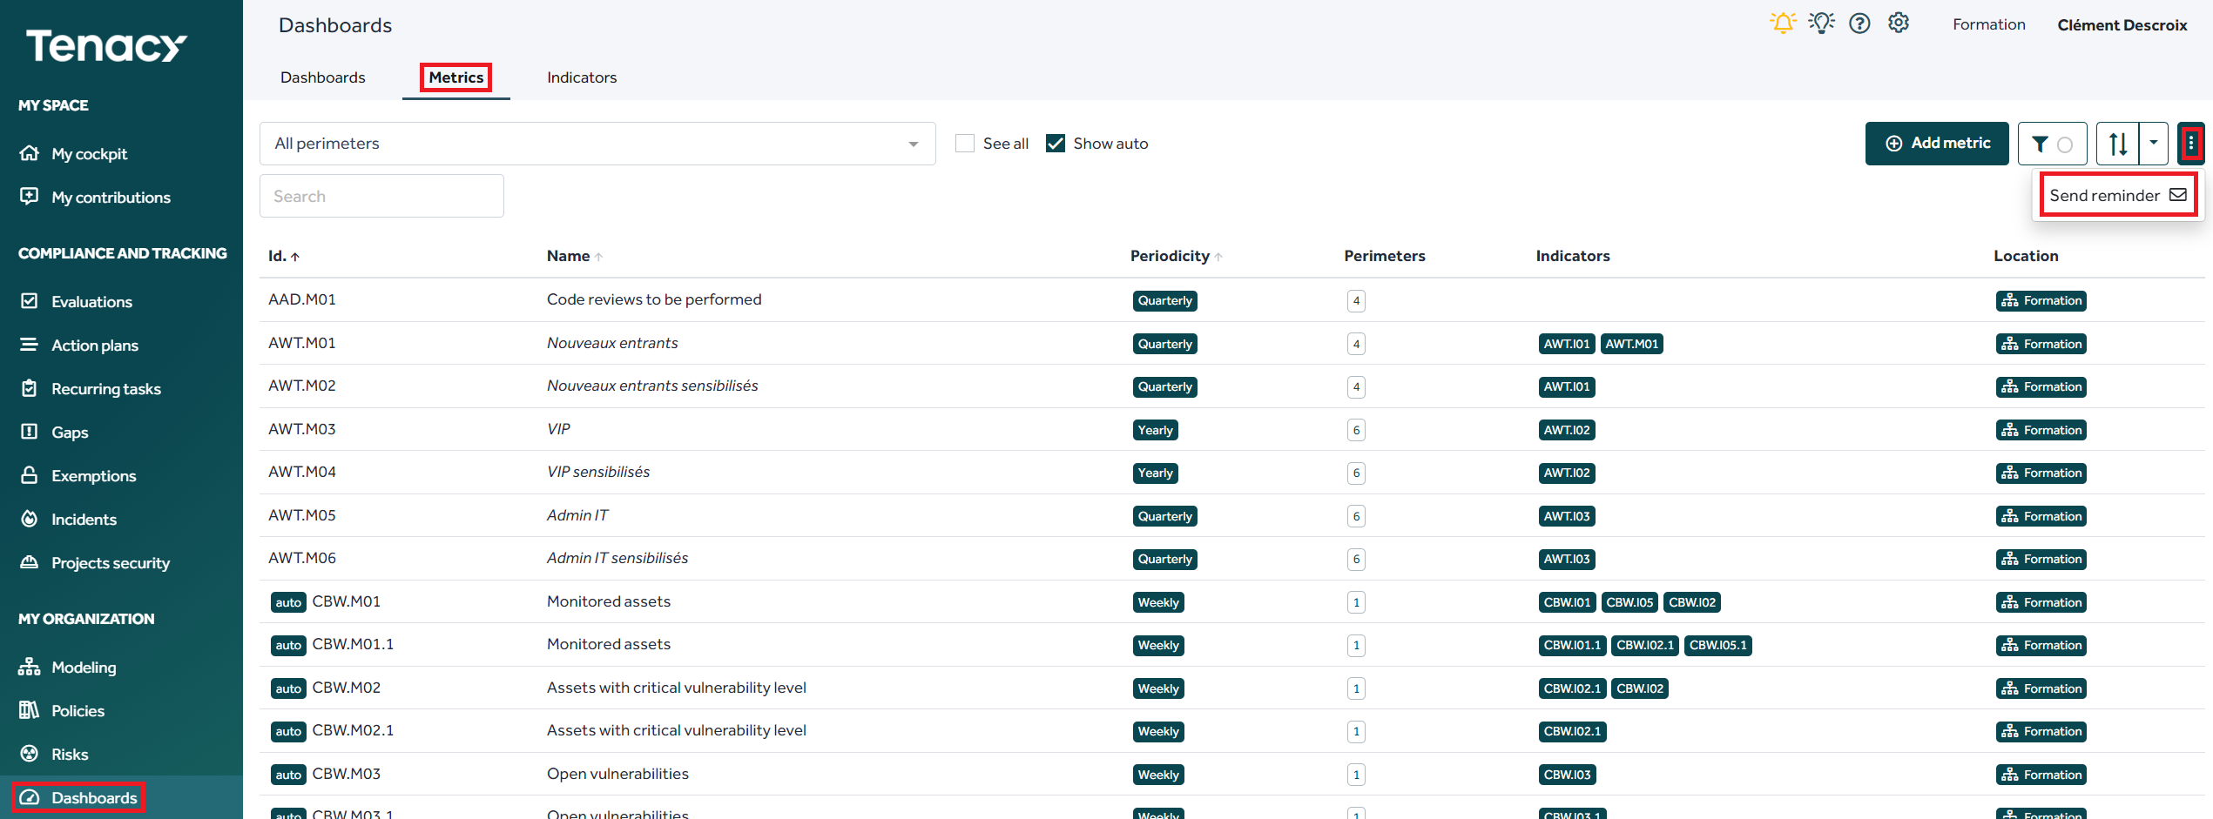
Reminders and notifications
Role : Pilot
Purpose: Send a manual reminder email for all metrics

Slide 37
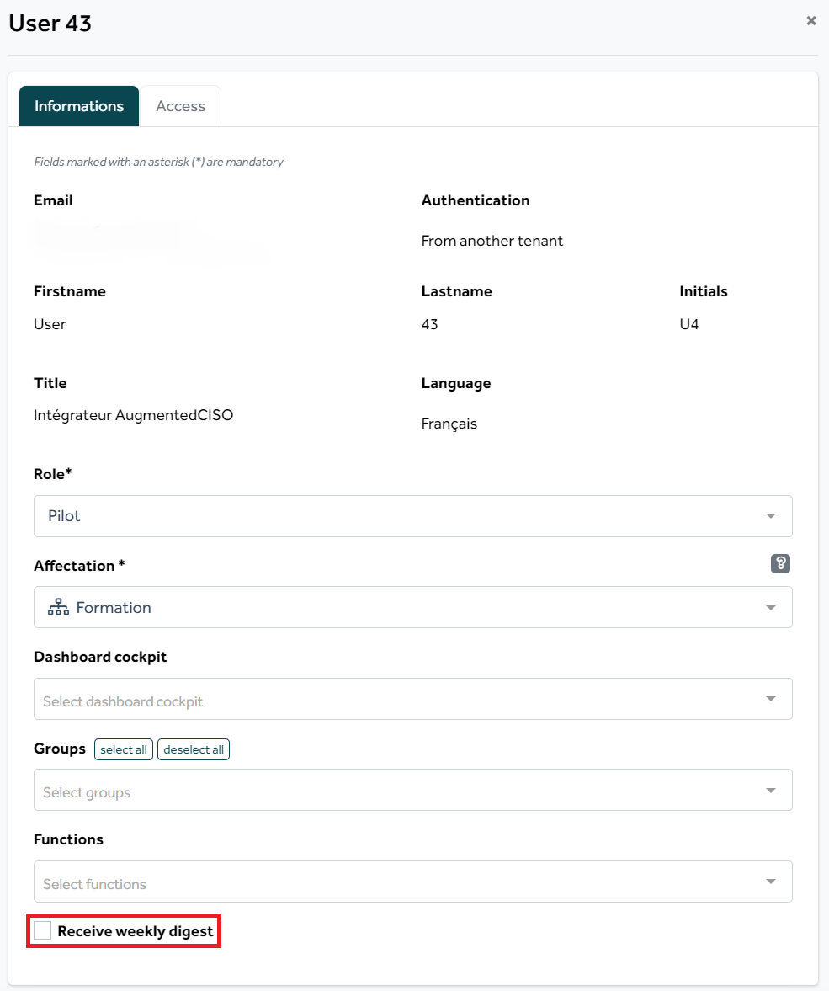
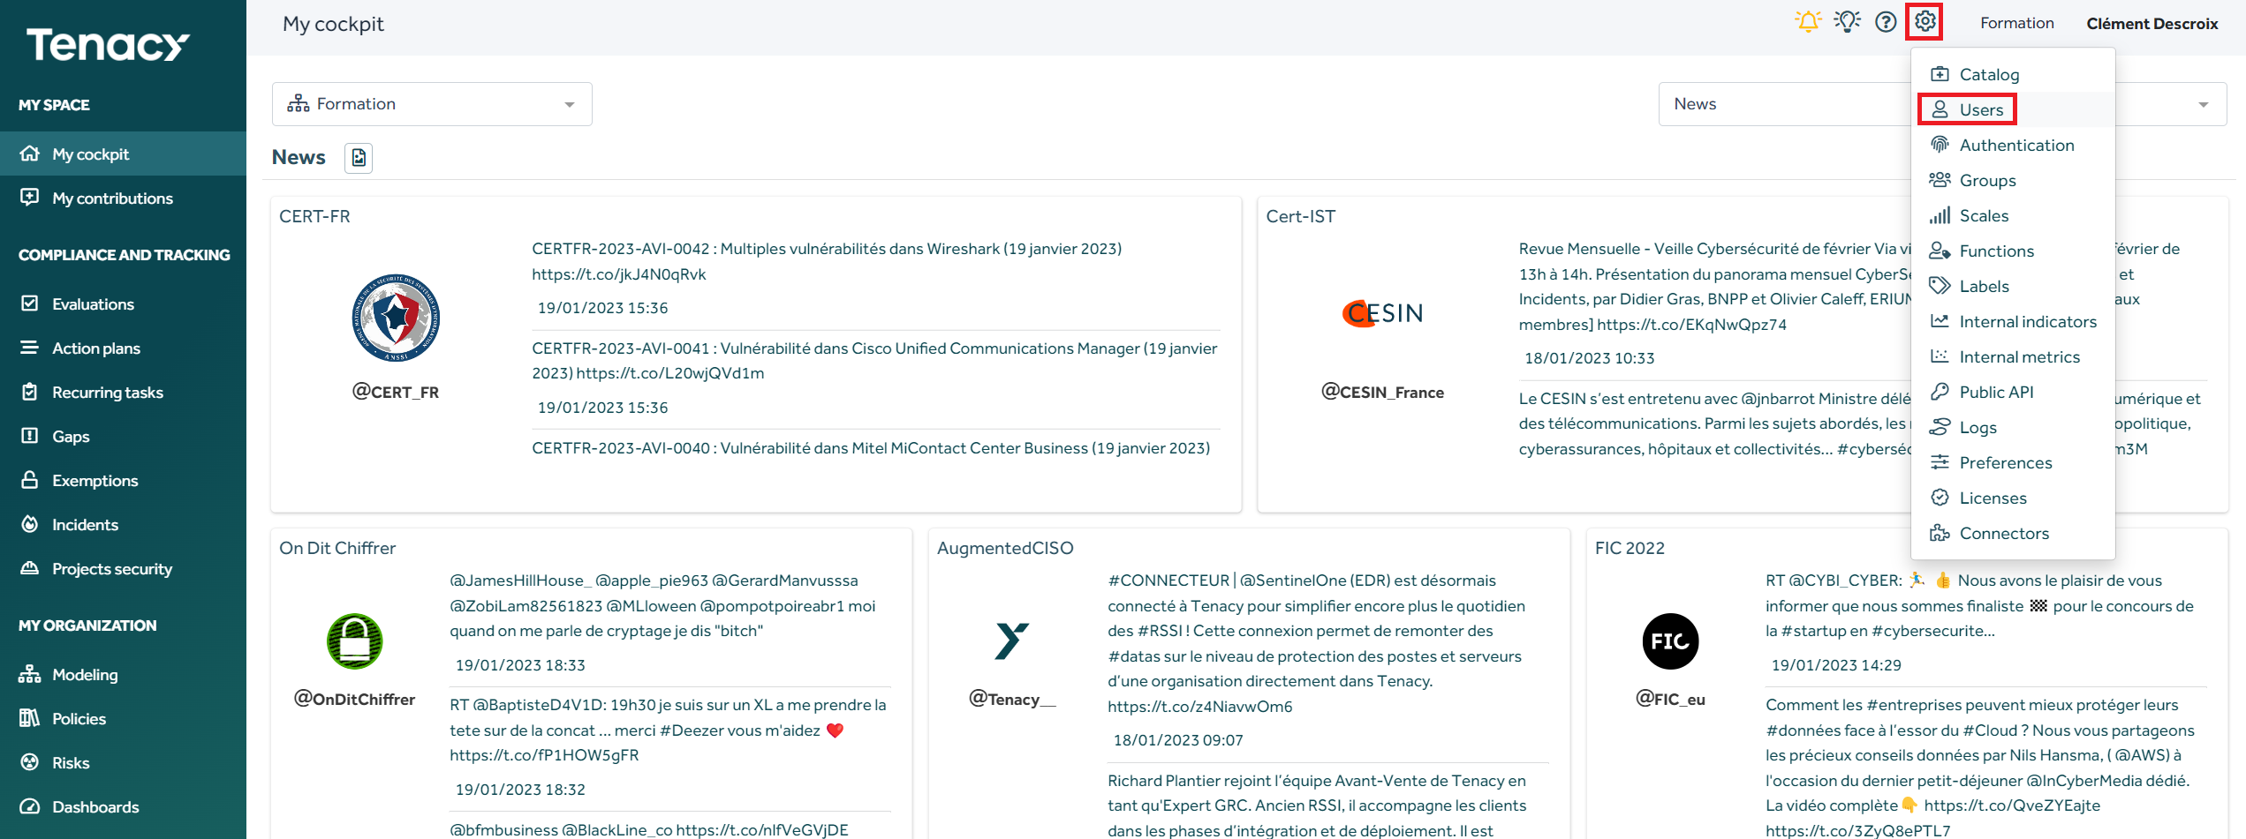
Reminders and notifications
The administrator can set a weekly reminder of actions for each user; it will be received every Monday morning
Rôle : Administrateur

Slide 38
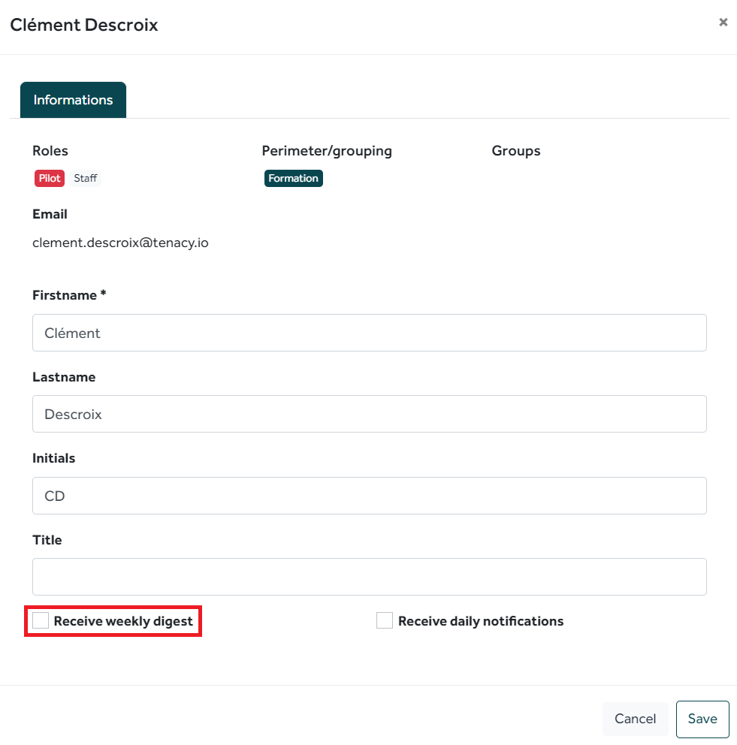
Reminders and notifications
A contributor can set a weekly reminder of the actions to be carried out for himself, it will be received all Monday morning
Rôle : Contributeur

Slide 39
To go further

Slide 40
Identify your safety goals and drive them
Define your own policies and link them to the knowledge base Tenacy Derive and customize public policies
Track your measured compliance level
Manage all your actions:
- Construction
- Improving
Define your reporting levels!
Assign actions and drive!
Define your means of control
KPI
Recurring tasks
Define your reporting levels!
Assign these objects and fly!
Policies
Action management
Run Drives

Slide 41
Thanks for the feedback and evaluations !
Merci
https://forms.office.com/r/d0a6s7YH0q
If you have any questions, or else, contact us on : support@tenacy.io

