Slide 1
1st Training Introduction to TENACY
V1.0
12/10/2022
Date

Slide 2
Interactions
Use and (abuse) of emojis
Activate your Mic / Webcam if desired
Use the chat to wrote your questions
Interactions should be limited to misunderstandings or clarifications of the concepts on the agenda
Special cases & implementations will be preferred over integrator / CSM workshops
👍 😍 😮😭🎉

Slide 3
What are we going to see in this workshop?

Slide 4
Main topics
Interfaces
Support & documentation
User management
Modeling your organization
Perimeters
Blok diagram
Security Measures
Security bases
Technical requirement
Apps and suppliers

Slide 5
Security perimeters
PERIMETER
OBJECTIVES
SECURITY BASES
POLICIES
MEASURES
RISKS

Slide 6
Security perimeters
OBJECTIVES
SUPPLIER
APP
POLICIES

Slide 7
Functional Model
Cover
Risks
Describe by
Indicators
(performance)
Measures
Covered by
Declined
(in a base)
Metrics
Offered
catalog
Policies
Describe by
Operated
Measured by
Indicators (activity)
Construction
Recurring tasks
Exemptions
Gaps
Projects security
Improve efficacity
Build by
Incidents
Actions
Simple Action
Improvement Action
Building Action

Slide 8
Functional Model for apps and suppliers
Policies
Project security
Actions
Simple Action

Slide 9
Summary : Management of the solution

Slide 10
Summary
Methods, supports et documentations
Technical requirement
Web interface
Mails are send by the solution by @tenacy.io
Documentation
support@tenacy.io
Support
Supported browsers : Edge, Firefox, Chrome & Safari (last versions)
Documentation in app in the menu at the top of the window
Chat (bottom left): the «hubspot» domain must be authorised
Tickets are tracked via chat (multi conversation)
Script execution(js) is mandatory on the domain
Contextual documentation adapted to the page you are on.
Ability to search for a keyword, browse documentation
The knowledge base includes tips and tricks (accessible via chat)

Slide 11
Summary
Rights management and access
At creation you must configure :
Its mail (la clé) and its name (to generate the initials)
The connection method (SAML or password)
Its role and scope of intervention: Roles cannot be cumulative.
Groups do not grant roles but rights over objects (actions, indicators etc.)
A user can be a member of multiple groups.
The functions are to be used in the evaluation framework
A weekly summary (Monday morning) can be configured for each user: it contains a reminder of the affected actions.
Reminders can also be sent manually (for a user or for a theme).

Slide 12
Summary
Metrics / internal indicators
Configuration / Preferences
Licences
Scale
Tenacy scores are set from 0 to 100
Calculated automatically by the solution.
Contains default values (scale, score etc.)
Admins users
Catalog
The proposed devices are templates present in the catalogue
The scale defines how this score is presented to the user (level, colors, title)
Cannot be edited by a user
Can be modified by media (exceptionally)
Can be inserted in a dashboard
Defy the political password
Contains the SAML configuration
Can be edited by a root admin
Support should be consulted prior to any changes
Internal perimeters
Public policy
Other elements are not limited in current licenses
Consult the support for any questions or extensions.
All objects in the catalogue (policy, devices, indicators, recurring tasks) are linked to each other.
Can be derived in your own catalog
Drift doesn’t mean instantiate!

Slide 13
Summary : Functional model

Slide 14
Model
Perimeters
Suppliers
Applications
Complete Fonctional Model
Policies / Risks
Actions
Exemptions / exceptions / incidents
Indicators & Recurring tasks
Simple Functional Model
Policie
Simple Action
Reporting
Subject to licensing
Dashboard
Simple Functional Model
Unlimited in number
Groups / Trees
Consolidating éléments (reporting)
Unlimited
Assigning rights
No assignment of objects on these elements: policies/ actions/ Measures
ISP
Policie
Simple Action
ISP
Reporting
Unlimited in number

Slide 15
Summary
Perimeters, Measures and Security base
All the measures that secure a perimeter
Composed of operated measures , offered and consumed
Compared to goals to calculate a score
Security base
Measures
Software and/or processes and/or team to secure a perimeter
Can be offered at different perimeters
Tenacy pivot element to link objects together.
Handled in different states in the solution
Can be analyzed for anomalies

Slide 16
Summary – The system in all its states
Proposed
Construction
Private
Enhancement
Operated
Offered / Consumed
Status
Efficacity
Status
No control (KPI, TR)
Private
Offered / Consumed
Template,
Created by Tenacy OR by User
Is available in the catalogue and must represent the link with other objects (objectives and means of controls)
&
Declined
Is present in the security bases
A same measure should not be twice in the same security base (even under 2 states)

Slide 17
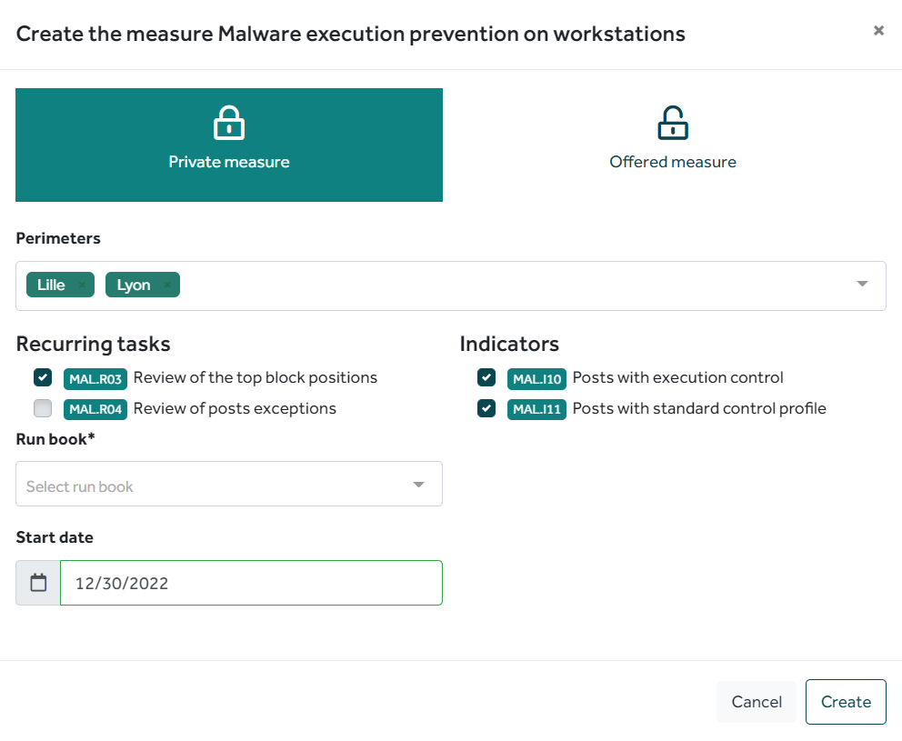
Measure modeling
1st Case : Double measure
Each perimeter will have his own measure (from the same offered measure)
Each perimeter will have its own Recurring Tasks
Each perimeter will collect its own metrics

Slide 18
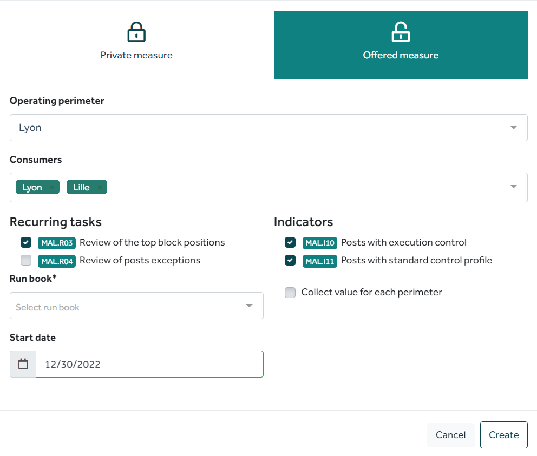
Measure modeling
2nde Cas : Offered Measure
Only one measure is created
Lyon is responsible for the measure
Only one RT instance will be created (under the responsibility of Lyon)
Only one metric will be collected: the indicator value will be the same for Lyon and Lille

Slide 19
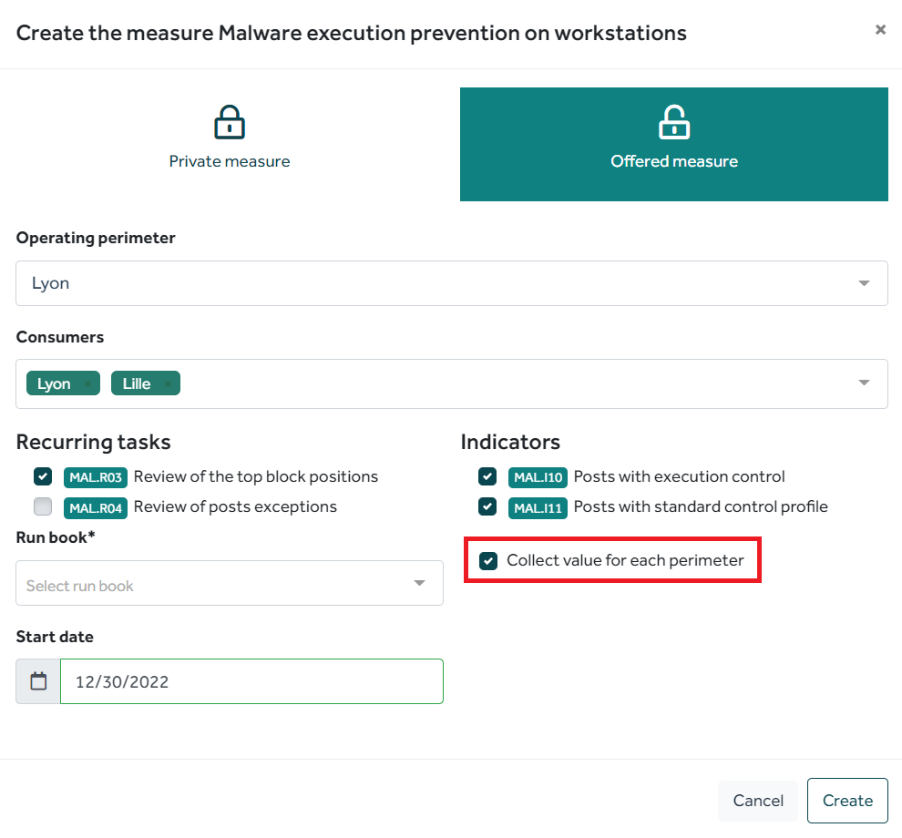
Measure modeling
3rd Case : Offered Measure in local
Only one measure is created
A single Recurrent Tasks body will be created (under the responsibility of Lyon).
Metrics are collected for each perimeter (Lyon may still be responsible for collecting for Lille)
A perimeter may be a consumer of the measure it offers (but not necessarily)

Slide 20
Create new items in measure catalog:
When should a proposed measure be derived? Build a proposed new measure ?
Creating a proposed measure in your catalog doesn’t mean instantiating
The device does not exist in our catalogue
You do not use the same root word, measure vision
Malware Protection = Endpoint Protection etc.
Cases encountered during specific measures (physical safety, ITIL organisation, etc.)
Change in theoretical coverage ratio
The device must be adapted several times
Redefining allows instantiating from this new model
Do not hesitate to refer us the case for integration in the public catalog.
It is preferable to instantiate and then modify the measure operated in the base
To define micro measures allows to gain in control finesse but will require more commitment: a measure = N measurements to link, indicators and/or Recurrent Tasks
If you derive a measure and modify it, you will need to manually apply the changes

Slide 21
In wich case a measure is operated ? (versus construction)
Construction
Operated
Can be completed to validate the status by:
Improvements
KPI/Recurrent tasks
Initial Build
Has a consequence on a risk: progress allows to cover the risk
Does not impact policy scores (but visible link)
Impact a risk and a policy (but reduced by the performance of the system)
Must be an identified / planned action → Target base
Within the same base the measure should not be under construction AND operated

Slide 22
Performance of measure
One of Tenacy’s purposes is to impact the measurement of the achievement of your objectives by the performance of the measures
Measured coverage
Operational performance
Completion of recurring tasks
Achievement of KPI objectives
Completion rate over the last 12 months of tasks due
Average performance/objectives indicator ratio
Efficiency of the device
Malus of reduction covered by one or more improvement actions
Theoretical coverage
Impact of the measure on the objective
Measure weighting on the objective.
Measures without controls will have an applied “operational performance” value for policy calculation. Configurable value for risks and policies

Slide 23
To go further

Slide 24
Identify your safety goals and drive them
Define your own policies and link them to the knowledge base Tenacy Derive and customize public policies
Track your measured compliance level
Manage all your actions:
- Construction
- Improving
Define your reporting levels!
Assign actions and drive!
Define your means of control
KPI
Recurring tasks
Define your reporting levels!
Assign these objects and fly!
Policies
Gestion des actions
Pilotages Run

Slide 25
Thanks for the feedback and evaluations !
Merci
https://forms.office.com/r/d0a6s7YH0q
If you have any questions, or else, contact us on : support@tenacy.io

